Slide 1
Good for Greens®
Plant growth regulator
15 November 2021

Slide 2
Future:
Redesigning photosynthesis will result in faster growth and higher yields
Modify chlorophyl to increase efficiency

Slide 3
Today:
First-Tree will help
Gradual transition
Circular agriculture

Slide 4
Results:
Participant dahlia pilot Delphy
Cherry pilot FruitConsult
Lily pilot Delphy
Vineyard pilots France
Selection period 2017 - 2021

Slide 5
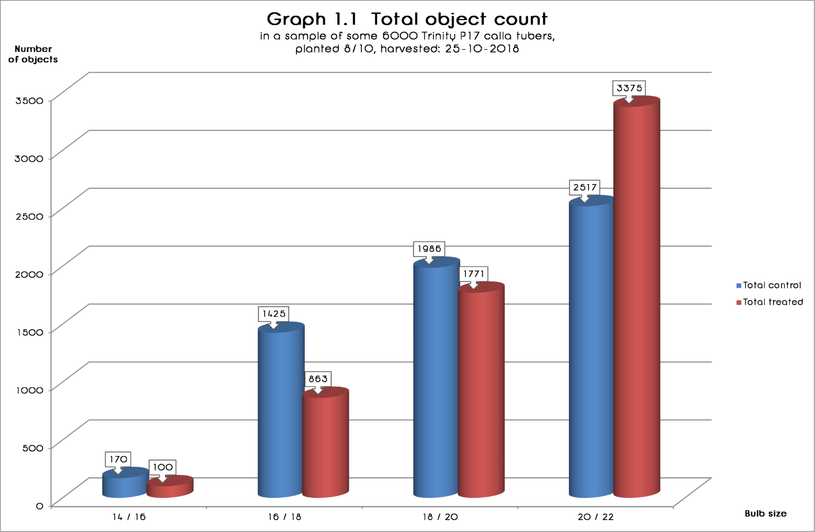
Calla Trinity

Slide 6
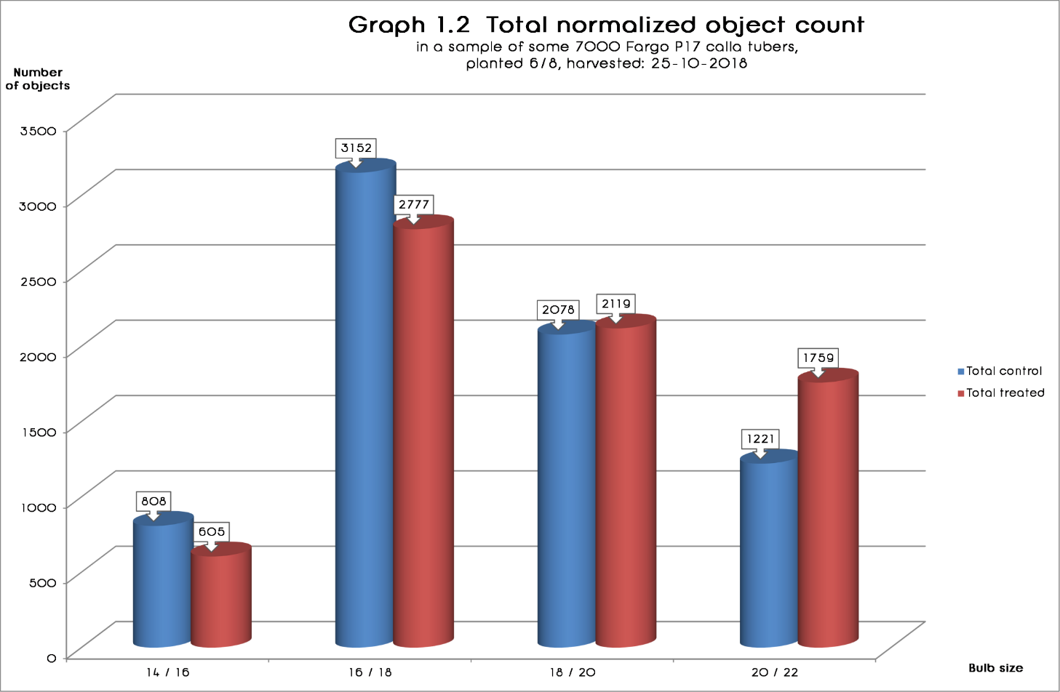
Calla Fargo

Slide 7
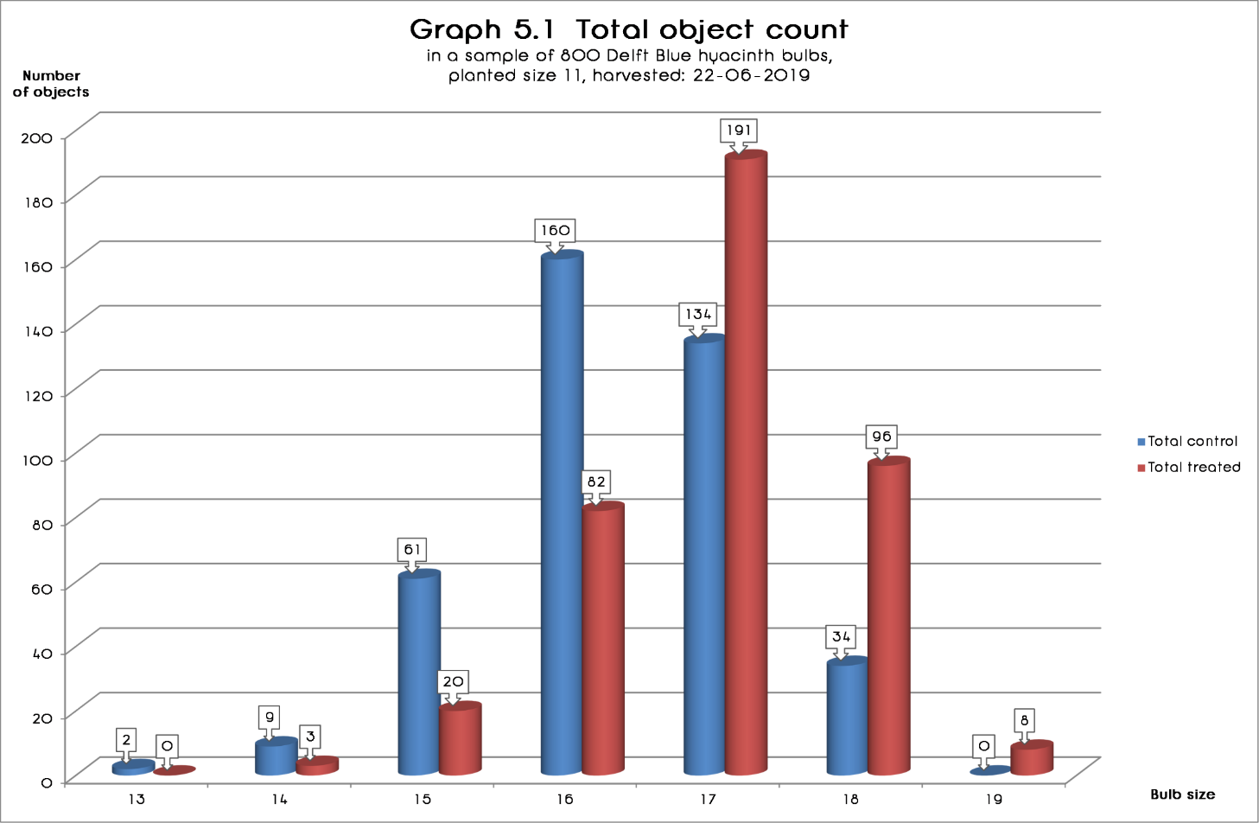
Delft Blue hyacinth

Slide 8
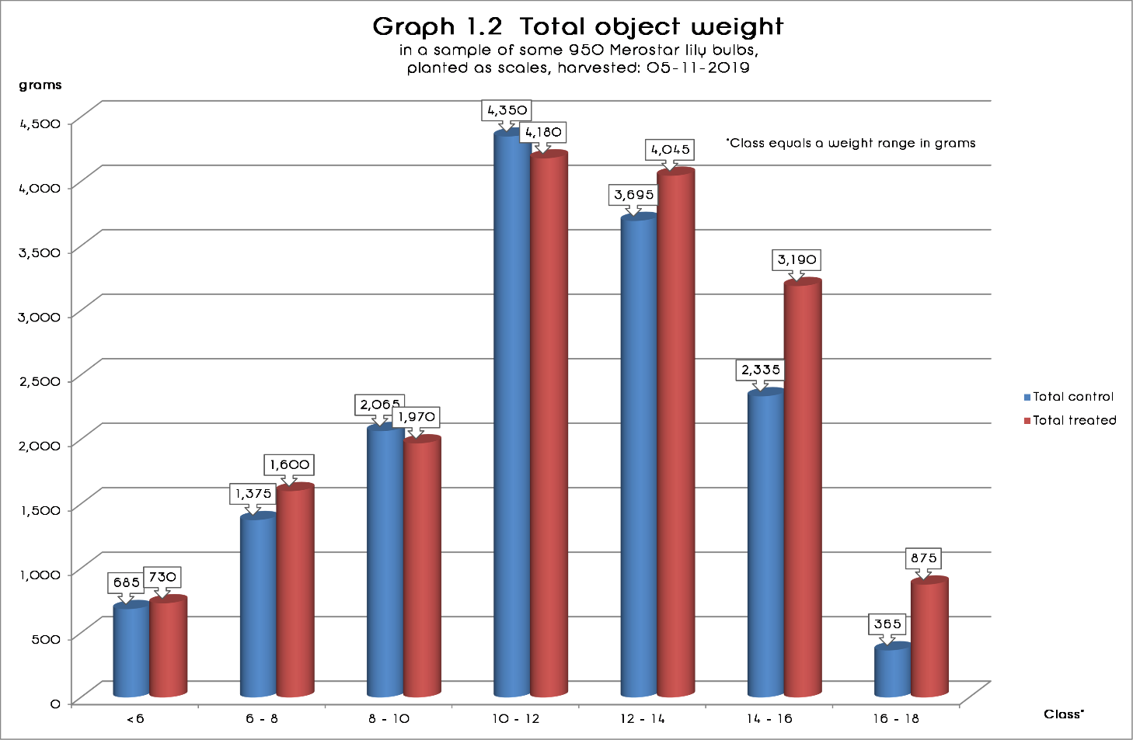
Merostar lily

Slide 9
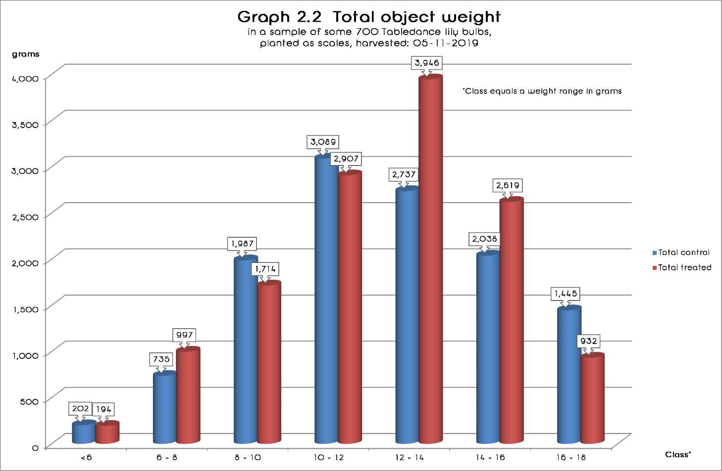
Tabledance lily

Slide 10
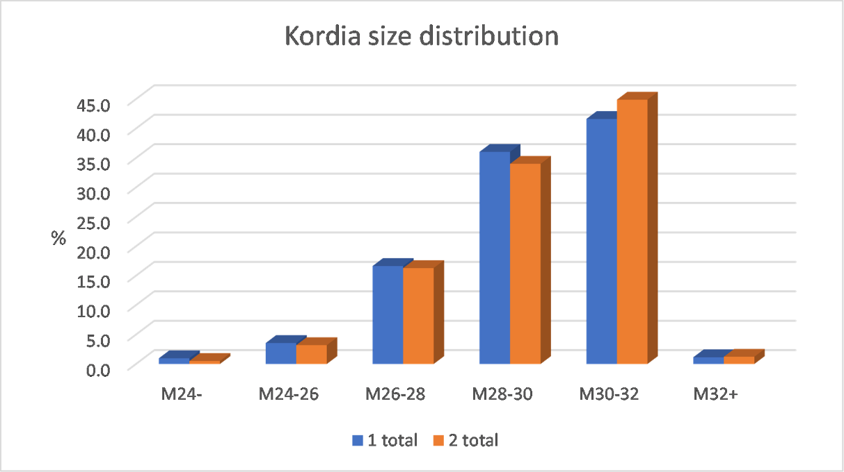
Kordia cherry

Slide 11
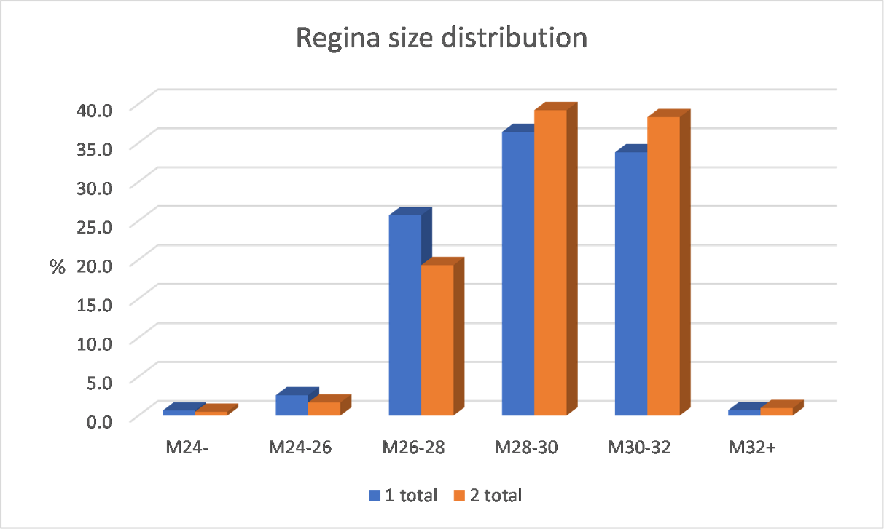
Regina cherry

Slide 12
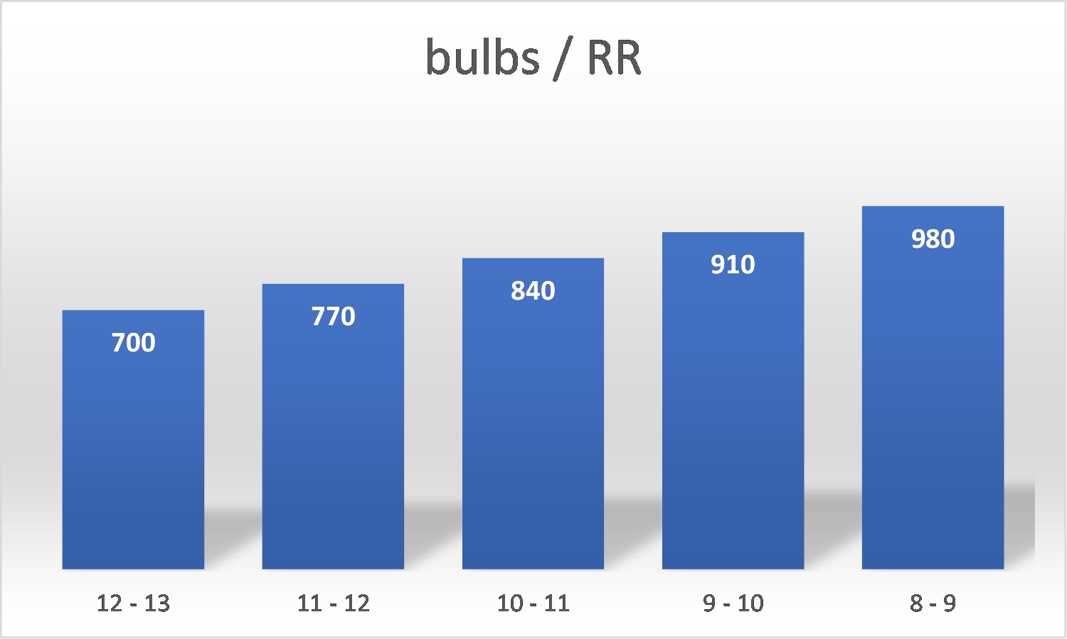
Assumptions CNB model

Slide 13
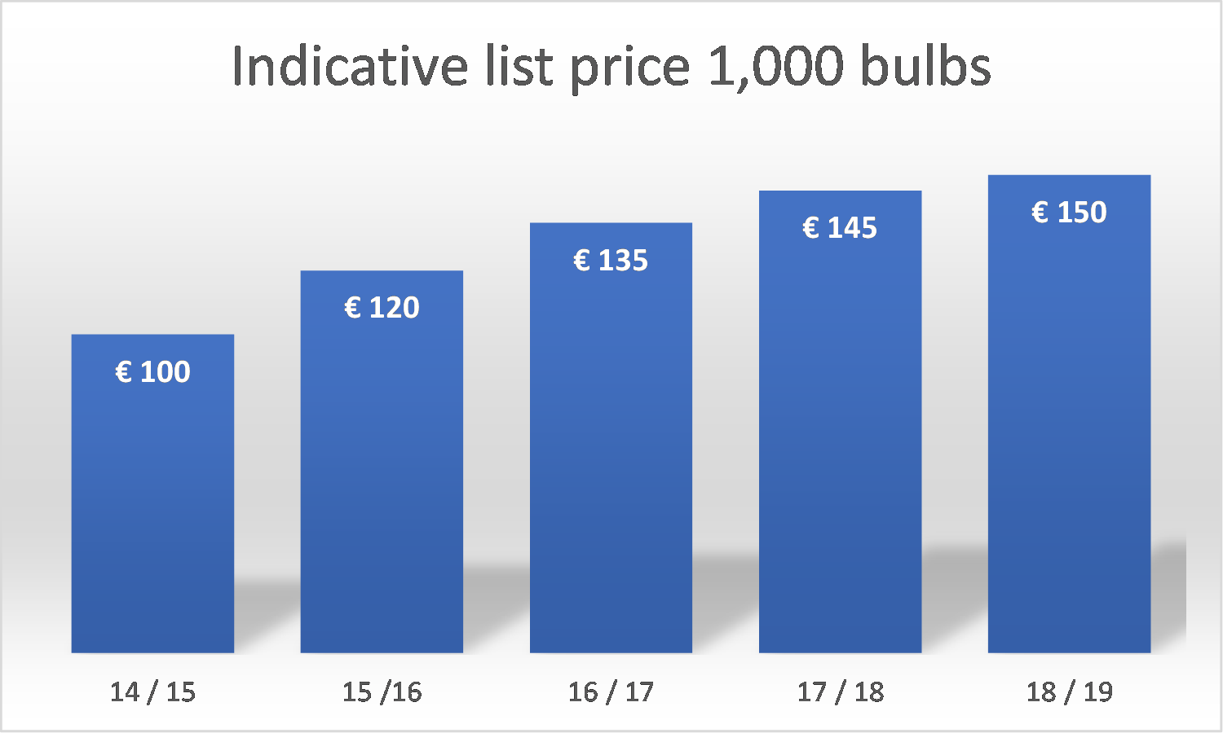
Assumptions CNB model

Slide 14
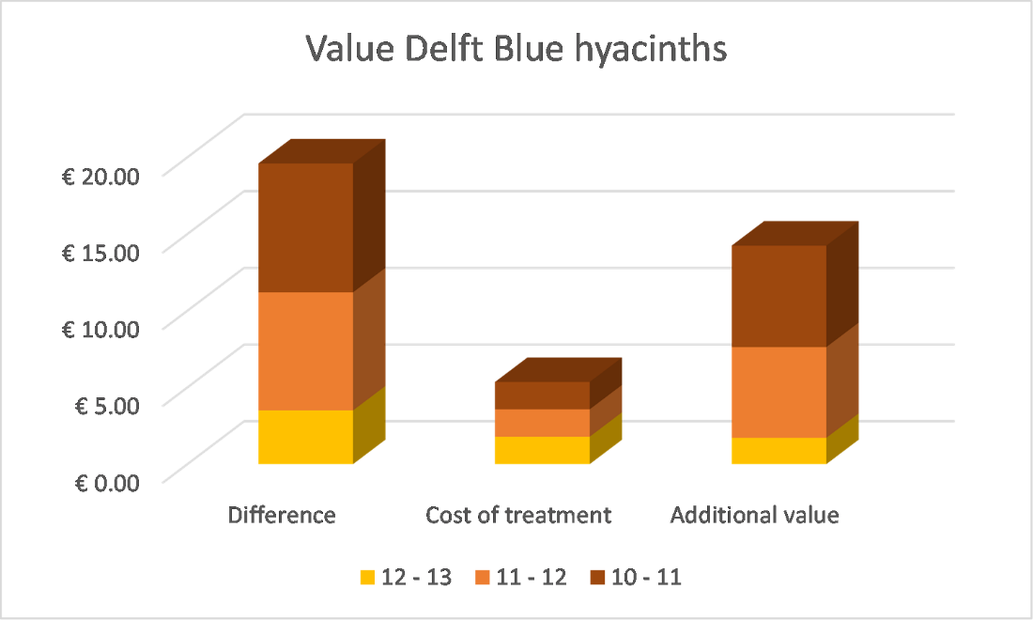
Value CNB model

Slide 15
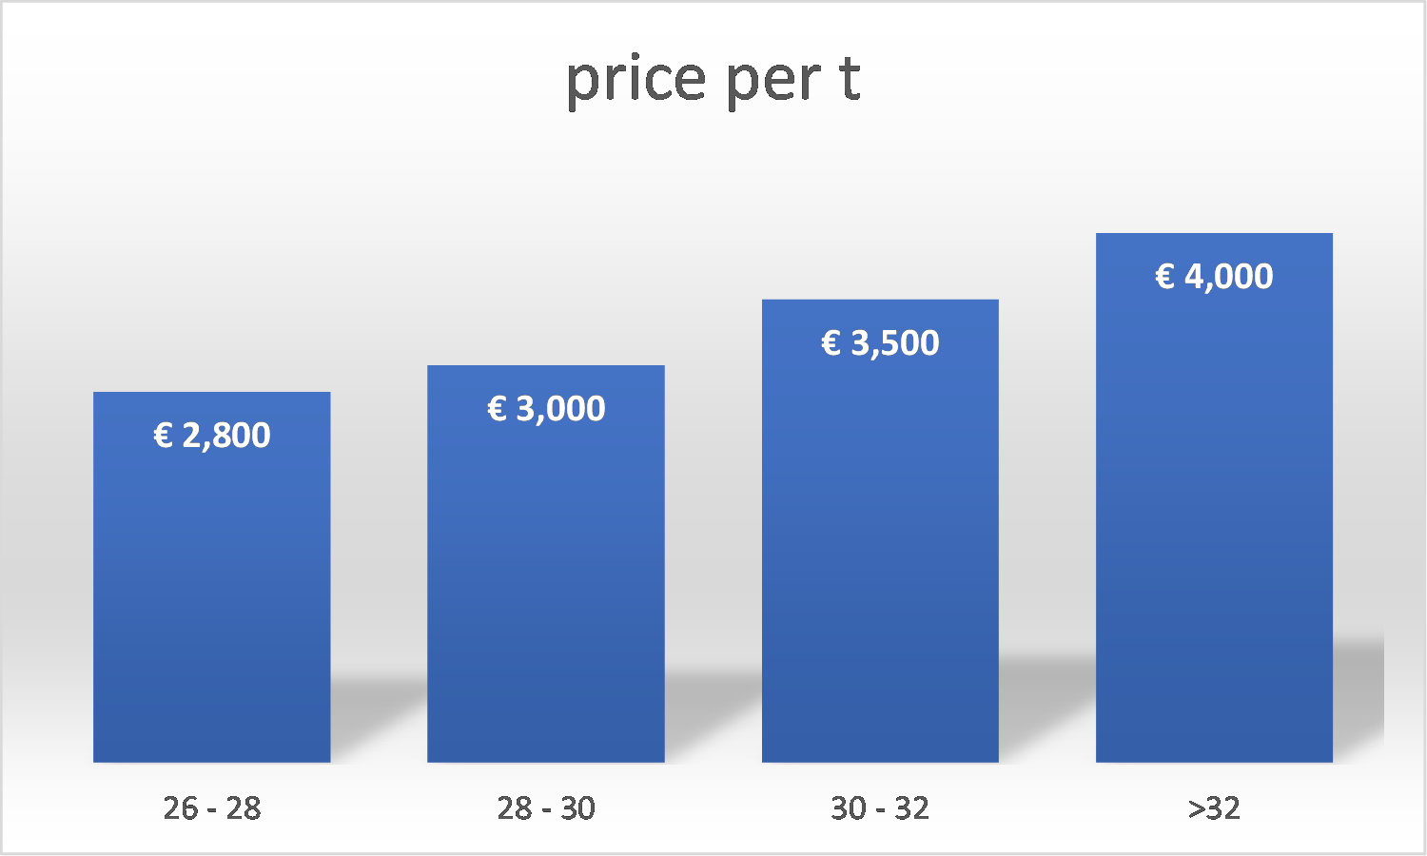
Assumptions cherry model

Slide 16
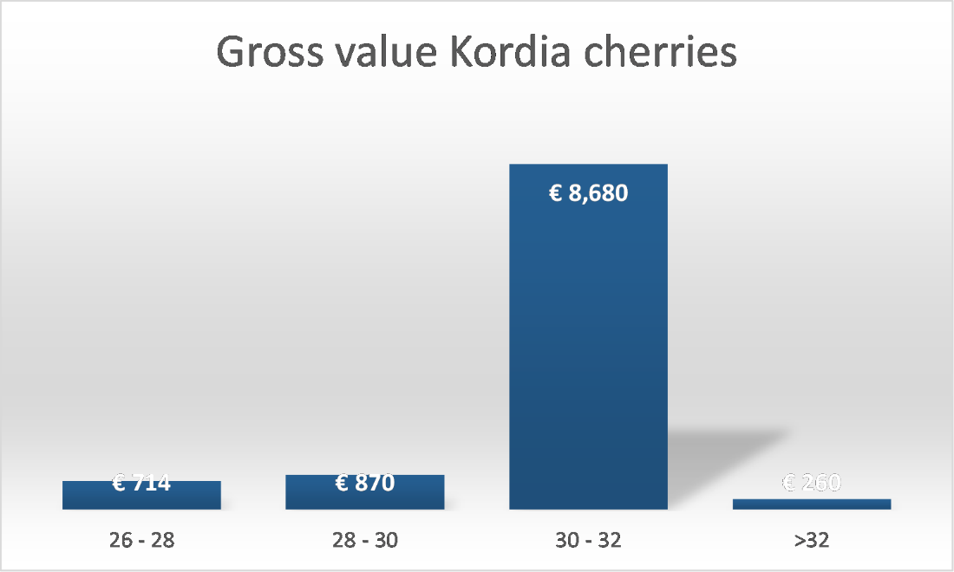
Value cherry model

Slide 17
Value cherry model

Slide 18
Conclusions
GOOD FOR GREENS increases yield, quality and storage time
GOOD FOR GREENS increases vitality
GOOD FOR GREENS increases income

